Slide 1
Your financial path to graduation
CFPB Section for Students and Young Consumers | 2020

Slide 2
Students need help estimating the long-term impacts of borrowing.
Of the ≈7,000 student loan borrowers who took the Financial Industry Regulatory Authority (FINRA) 2018 Financial Capability Study:
42% | 48% | 43% | 47%
were late with at least one payment in the previous year | were concerned that they wouldn’t be able to pay off their student loans. | calculated monthly student loan payment before borrowing. | wish they had chosen less expensive colleges.

Slide 3
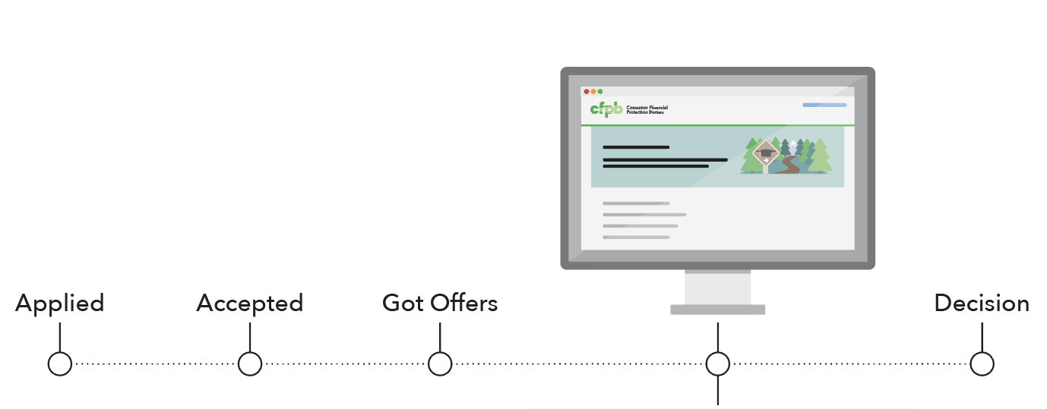
This tool helps students make final decisions about where (or whether) to go to school—and how to pay for it.
Your financial path to graduation
Does my funding cover my costs?
Can I afford the loans I’ll need?
Is this school worth it for me?

Slide 4
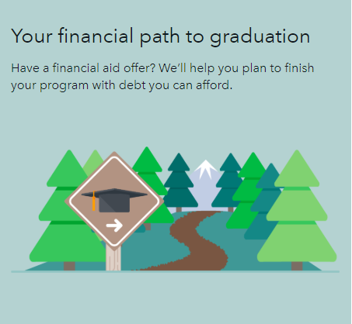
We used this research to build a tool that equips students to turn financial aid offers into plans to pay for school.
This tool provides students and families with:
An interactive plan that can be saved and revised
Simple explanations of jargon and financial concepts
Money saving tips
Running total of uncovered costs
Projected debt and information to help decide if it’s affordable
Apples-to-apples comparisons of multiple aid offers
Suggested next steps
www.consumerfinance.gov/gradpath

Slide 5
Postsecondary institutions: Join our pilot and set up students for success in paying for school.
Piloting the tool requires no new software and no data sharing!
How to use the tool
Pilot benefits
Send individualized, prepopulated links to students
Designed for advisers to use in giving students current, tailored guidance
Save and revise personal plans without exposing student data
Regular updates and improvements
Schools set the parameters
Opt-in assistance with IT setup, quality assurance, and impact evaluation
Quarterly calls with other pilot schools
Opportunities to co-present with the CFPB at conferences
Everything is free!

Slide 6
Counselors and college access advisers: Join our pilot and set up students for success in paying for school.
Piloting the tool requires no new software and no data sharing!
How to use the tool
Pilot benefits
Easily generate financing plans for each student for easy comparison
Designed for advisers to use in giving students current, tailored guidance
Save and revise personal plans without exposing student data
Regular updates and improvements
Organizations set the parameters
Opt-in assistance with impact evaluation
Quarterly calls with other pilot participants
Opportunities to co-present with the CFPB at conferences
Everything is free!

